Slide 1
FAQ:
Q. How do I reset the links on the main board back to yellow?
A. Simply close the PowerPoint file, and re-open, and the links will turn back to yellow.
Q. Can I use this in Keynote / Google Slides / Open Office?
A. Sorry, but Google slides, Keynote, Open Office etc. are not supported. Those are great programs but they’re not made to handle a file with this animation complexity.
Q. Why aren’t the sound effects working?
A. If the sound effects aren’t working, I would suggest upgrading your PowerPoint to something newer than 2008, and using a PC instead of a Mac if possible. Also, Google slides, Keynotes, etc. are not supported.
Q. Can I get a board with less categories? Can I add a custom logo?
A. Unfortunately these changes are a little too complex for me to explain or assist you via email, but if you’d like me to do a custom job for you for a small fee, send me an email at Reid@youthdownloads.com. You can also try using an App I made called TriviaMaker which lets you easily create Jeopardy style games and customize the number of categories, colors and logo at www.TriviaMaker.com
Q. Is there a tutorial I can watch to edit / play this game?
A. Yes. To see it in action, or learn how to make edits, watch this video: https://youtu.be/tDC1mXh9NPE
Notes:
Family Feud Template
Introduction Slide – Family Feud!

Slide 2
JEOPARODY JEOPARODY JEOPARODY JEOPARODY JEOPARODY JEOPARODY JEOPARODY JEOPARODY JEOPARODY JEOPARODY JEOPARODY JEOPARODY JEOPARODY JEOPARODY JEOPARODY JEOPARODY JEOPARODY JEOPARODY JEOPARODY
JEOPARODY JEOPARODY JEOPARODY JEOPARODY JEOPARODY JEOPARODY JEOPARODY JEOPARODY JEOPARODY JEOPARODY JEOPARODY JEOPARODY JEOPARODY JEOPARODY JEOPARODY JEOPARODY JEOPARODY JEOPARODY JEOPARODY

Slide 3
HERE ARE TODAY’S CATEGORIES

Slide 4
Picture

Slide 5
Synonyms

Slide 6
Antonyms

Slide 7
Fill in the Blank

Slide 8
In Your Own Words

Slide 9
Definitions

Slide 10
Picture
Synoyms
Antonyms
Fill in the Blank
In Your Own Words
Definitions
$100
$100
$100
$100
$100
$100
$200
$200
$200
$200
$200
$200
$300
$300
$300
$300
$300
$300
$400
$400
$400
$400
$400
$400
$500
$500
$500
$500
$500
$500
FINAL JEOPARODY

Slide 12
Lancet

Slide 13
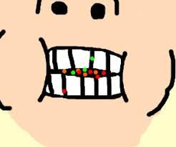

Slide 14
Masticate

Slide 15
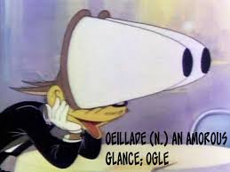

Slide 16
Ogle

Slide 18
Pacifist

Slide 19
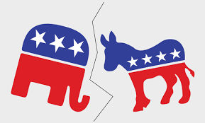

Slide 20
Partison

Slide 21
Exerpt

Slide 22
Passage

Slide 23
Supporter

Slide 24
Partisan

Slide 25
Scalpel

Slide 26
Lancet

Slide 27
Stare

Slide 28
Ogle

Slide 29
Chew

Slide 30
Masticate

Slide 31
Hostile

Slide 32
Pacifist

Slide 33
Chapter

Slide 34
Passage

Slide 35
Blunt

Slide 36
Lancet

Slide 37
Ignore

Slide 38
Ogle

Slide 39
Unbiased

Slide 40
Partison

Slide 41
He belongs to the democratic ________ group.

Slide 42
Partison

Slide 43
Please look for the answer in the _______.

Slide 44
Passage

Slide 45
Some students ___________ on pens.

Slide 46
Masticate

Slide 47
The doctor used the ______ during surgery.

Slide 48
Lancet

Slide 49
Try not to _____ her new haircut.

Slide 50
Ogle

Slide 51
Eat and chew

Slide 52
Masticate

Slide 53
a reading paragraph

Slide 54
Passage

Slide 55
A peaceful person

Slide 56
Pacifist

Slide 57
Look and focus on something odd

Slide 58
Ogle

Slide 59
Devoted to a cause or political group

Slide 60
Partison

Slide 61
A surgical knife with a pointed double-edged blade

Slide 62
Lancet

Slide 63
Stare at; observe in an obvious manner

Slide 64
Ogle

Slide 65
Devoted to a cause or political group

Slide 66
Partison

Slide 67
Bite and grind with the teeth

Slide 68
Masitcate

Slide 69
Opposed to war

Slide 70
Pasifist

Slide 72
Choose one of our previous words and define it.
GO TO
PROMPT
(RESPONSE)
Start Timer

Slide 73
Answers will vary!

